Slide 1

STES’S Sou. Venutai Chavan Polytechnic, Pune Dept. of Computer Technology
MSBTE
Year 2017-2018
19/09/2017

Slide 2
Garbage Monitoring & Management
Presented by
04 Prajval Santosh Chavan
08 Sumit Rajaram Ghadi
21 Sairaj Vivek Nanaware
30 Sameer Laxman Sawant
Guide - Mrs. S M Mate

Slide 3
Index
Abstract
Existing System
Proposed System Achitecture
Components
Disadvantages of the existing system
Advantages of the proposed system

Slide 4
Abstract
Many times, in our city we see that the garbage bins or dustbins placed at public places are overloaded. It creates unhygienic conditions for people as well as ugliness to that place leaving bad smell. To avoid all such situations we are going to implement a project called IoT Based Smart Garbage Collection system.
We are also providing waste management by seperating wet trash and dry trash.

Slide 5
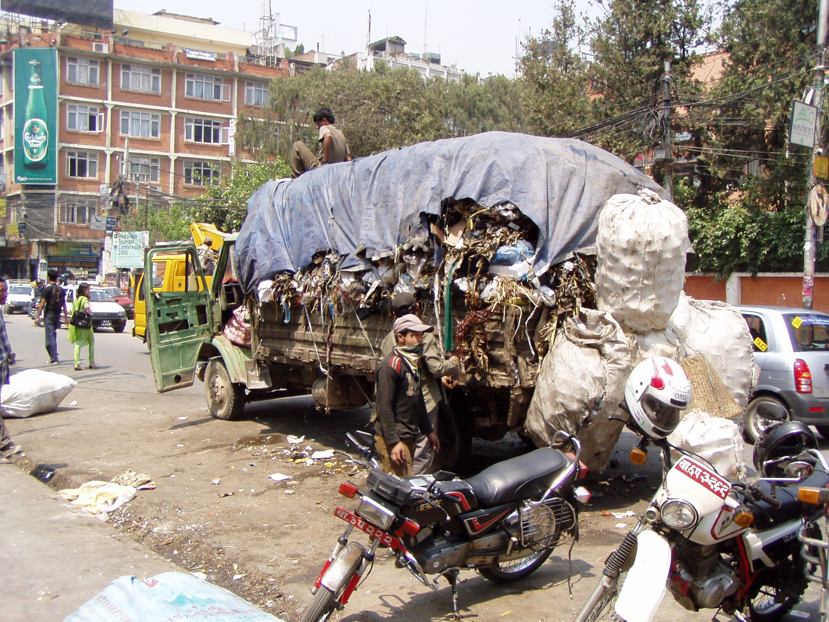
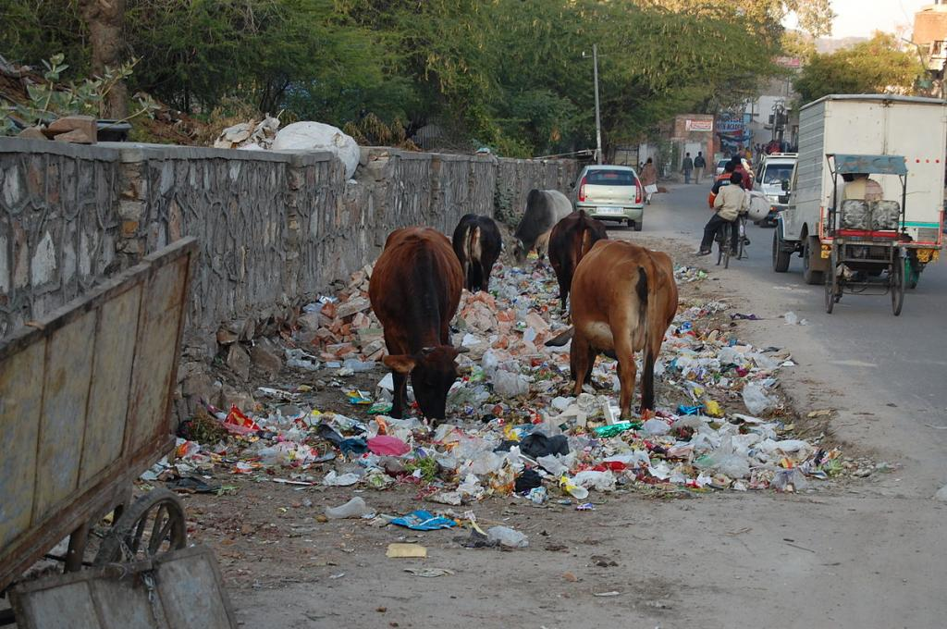
Existing System

Slide 6
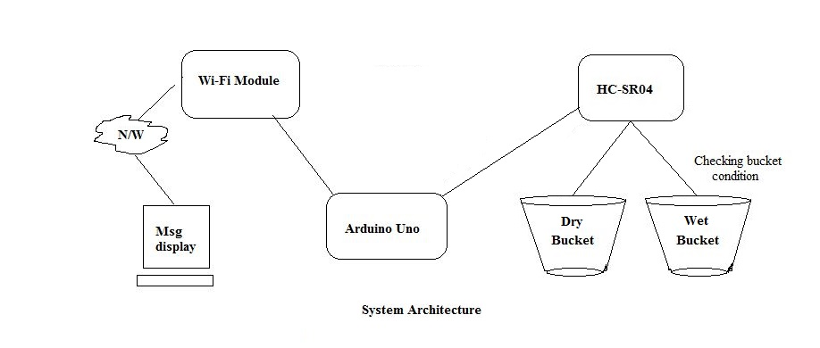
Proposed System Achitecture

Slide 7
Components
Arduino Uno
ESP8266 Wi-Fi module
HC-SR04 Ultrasonic sensor
1K Resistors
Breadboard
Connecting wires

Slide 8
Arduino Uno
The Arduino Uno is a microcontroller board based on the ATmega328. It has 20 digital input/output pins, a 16 MHz resonator, a USB connection, a power jack, an in-circuit system programming (ICSP) header, and a reset button. It simply connect it to a computer with a USB cable or power it with a AC-to-DC adapter or battery to get started.
It features an ATmega16U2 programmed as a USB-to-serial converter. This auxiliary microcontroller has its own USB bootloader, which allows advanced users to reprogram it.

Slide 9
Ultrasonaic-Sensor-HC-SR04
The Ultrasonic Sensor is used to measure the distance with high accuracy and stable readings. It can measure distance from 2cm to 400cm or from 1 inch to 13 feet. It emits an ultrasound wave at the frequency of 40KHz in the air and if the object will come in its way then it will bounce back to the sensor. By using that time which it takes to strike the object and comes back, you can calculate the distance.
The RX pin works on 3.3V so you will have to make a voltage divider for it.

Slide 10
ESP8266 Wi-Fi Module
ESP8266 is a Wi-Fi module which will give access to Wi-Fi or internet. It is a very cheap device but it will make your projects very powerful. It can communicate with any microcontroller. It is in the list of most leading devices in the IOT platform. It runs on 3.3V and if you will give it 5V then it will get damage.
The ESP8266 has 8 pins; the VCC and CH-PD will be connected to the 3.3V to enable the Wi-Fi. The TX and RX pins will be responsible for the communication of ESP8266 with the Arduino

Slide 11
Disadvantages of the existing system
Time consuming and less effective: trucks go with an empty containers whether they are full or not.
High costs.
Unhygienic Environment and look of the city.
Bad smell spreads and may cause illness to human beings.

Slide 12
Advantages of the proposed system
Real time information on the fill level of the dustbin. Deployment of dustbin based on the actual needs.
Cost Reduction and resource optimization. Improves Environment quality
Fewer smells
Cleaner cities
Intelligent management of the services in the city. Effective usage of dustbins.

Slide 13
Thank You.......

